Slide 1

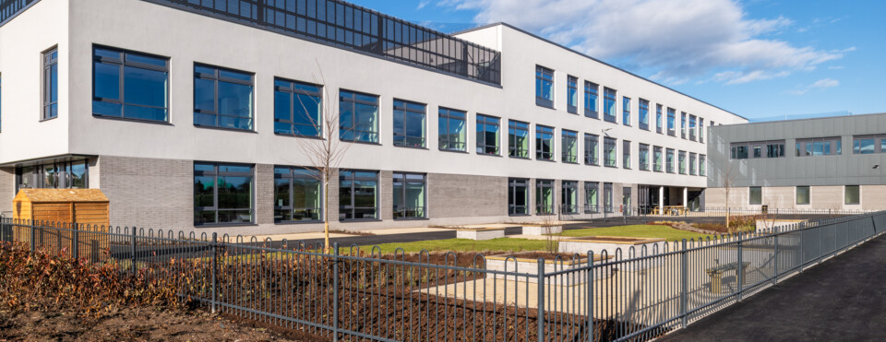
Rights in Lossiemouth High School
Progress this year
Pupil Assemblies – 24th June 2022

Slide 2




What is a Rights Respecting School and why does it matter? https://youtu.be/wJeFy4CVs6o

Slide 3
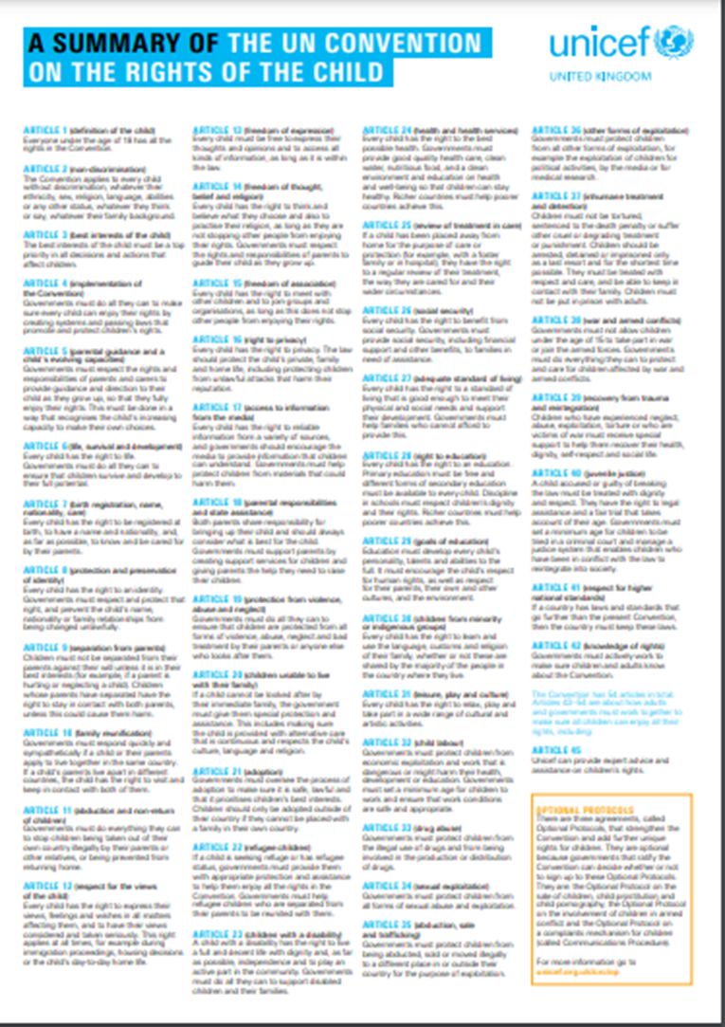
The Journey so far
Silver towards Gold
June 2021
Achieved Rights Respecting Schools Award
Aug. 2021
Onwards – journey
June 2022
Rights Week
January 2022
Staff/pupil/parent survey

Slide 4

RRS Pupil Steering Group
Working with UNICEF OutRight Campaign on mental health
Letters to MSPs on MH in Scottish Schools
Attended Parent Partnership meeting
Parent Council sourced funding for Scottish Parliament trip 9 June 2022 to meet with Richard Lochhead and Douglas Ross

Slide 5
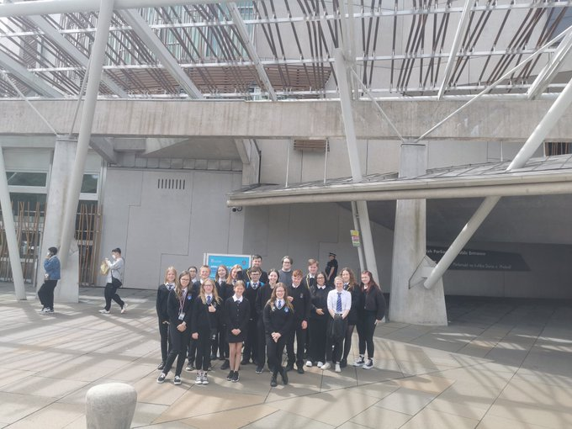
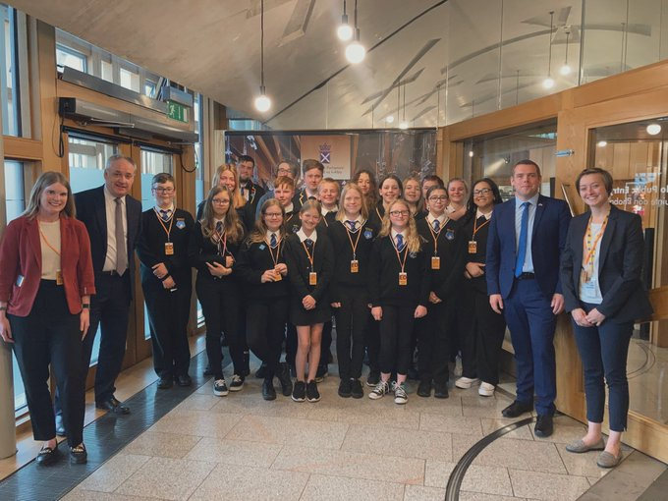
Visit to Scottish Parliament – Pupil steering group
9 June 2022

Slide 6

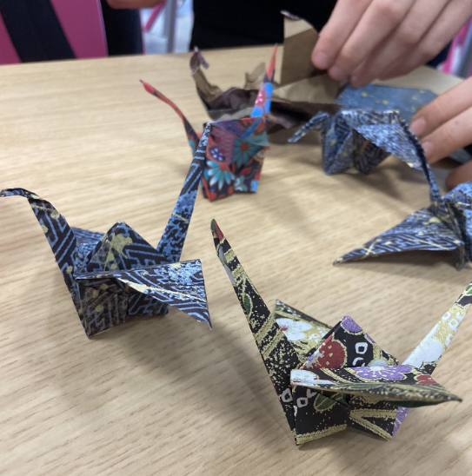

Rights week, Rice and Global Citizenship
Rights week w/b 13th of June.
Peace Crane project
The 90Kg rice challenge
Drama Performance
Filming about rights

Slide 7
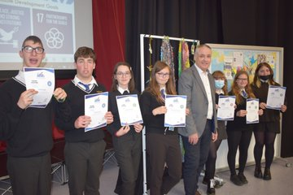
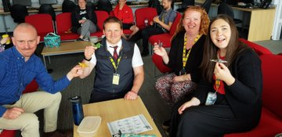
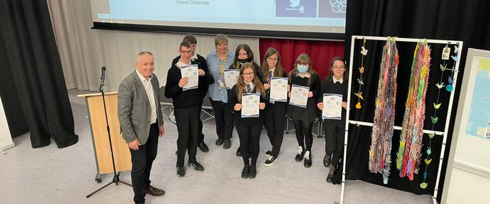
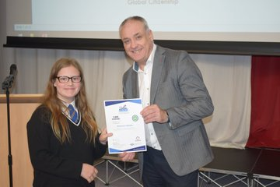
Peace Cranes and Richard Lochhead visit

Slide 8
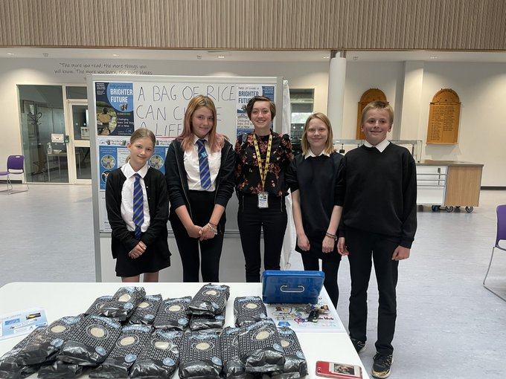
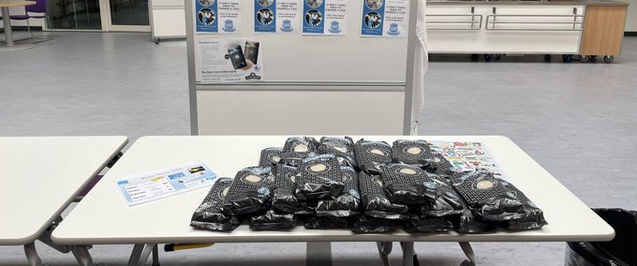
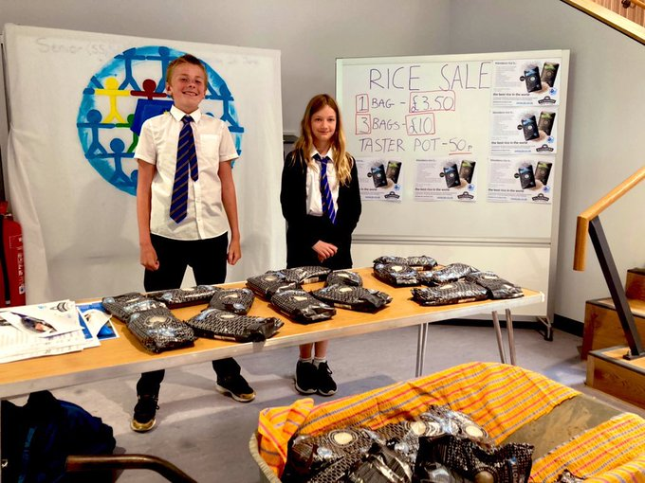
90kg Rice Challenge

Slide 9
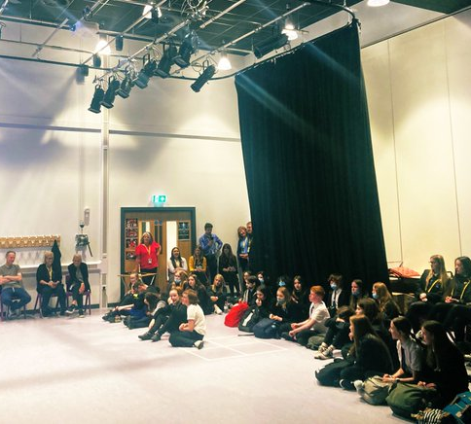
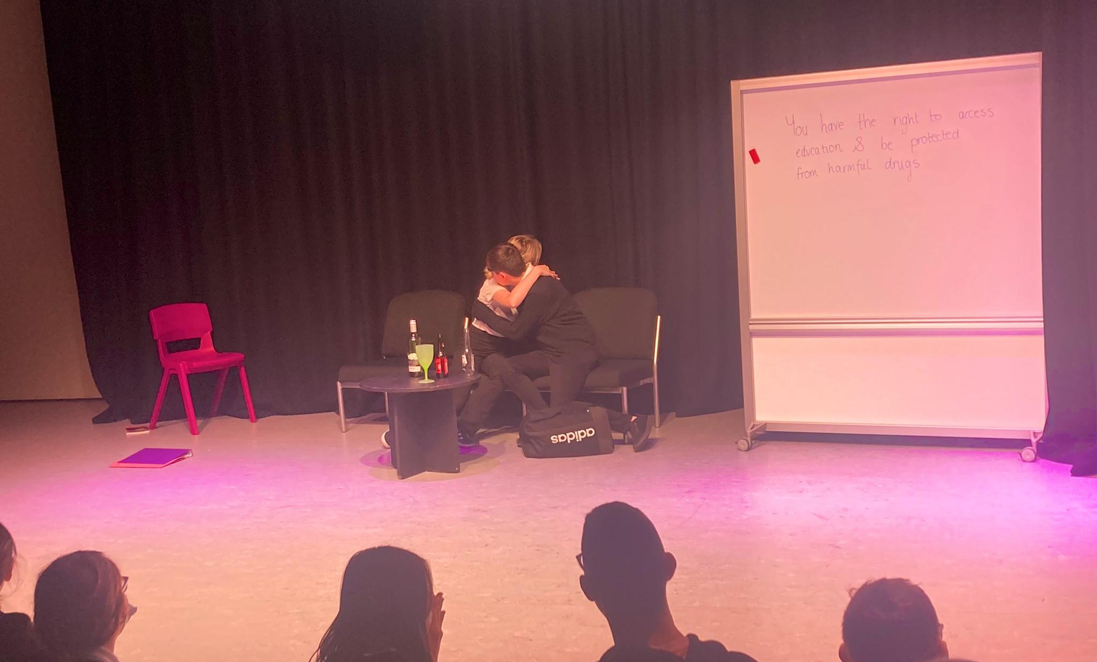
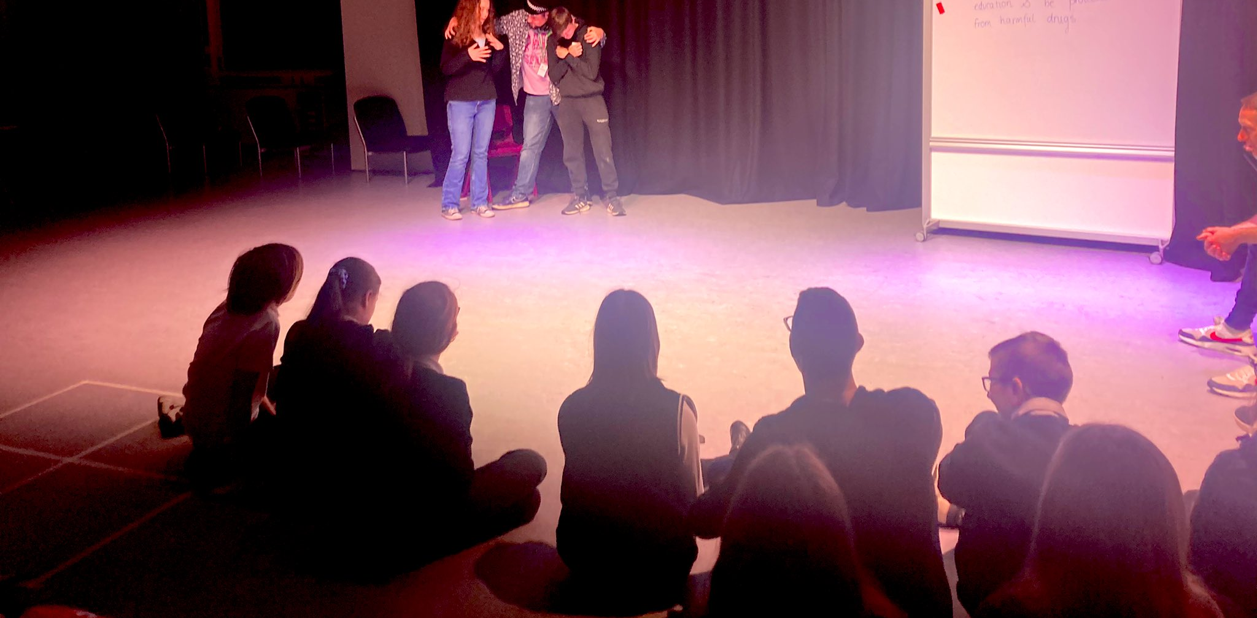
Drama Freeze-Frame Rights Performance

Slide 10
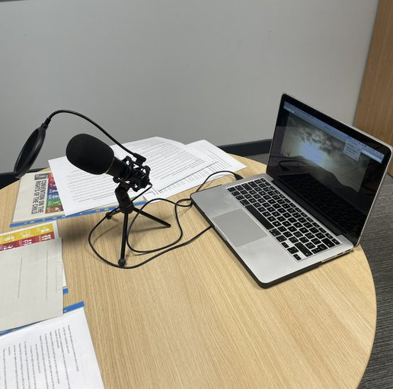
Rights Week – pupil and staff filming of rights

Slide 11
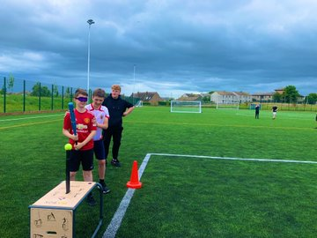
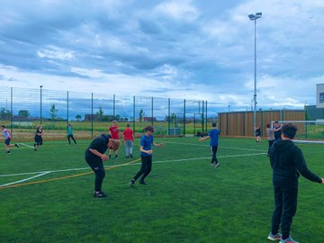
Educating S3 about UNCRC Article 2 No Discrimination today in PE as part of Rights Week

Slide 12
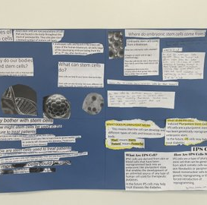
S3 Biology researching stem cells and considering the UNCRC and discussing ethic’s during rights week.

Slide 13
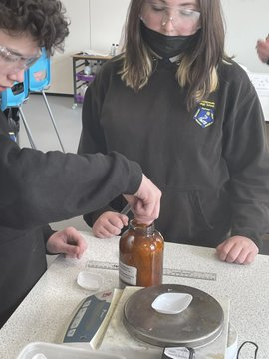
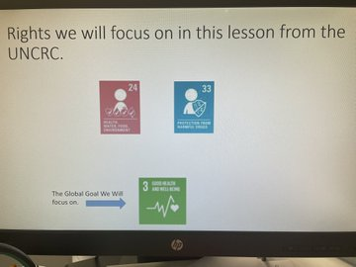
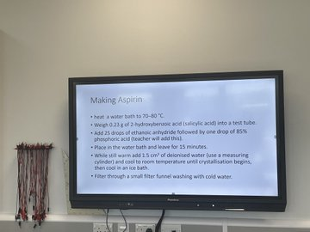
Rights Week - S3 Chemists have been making Aspirin in the lab and discussing UNCRC rights to good health and protection from harmful substances like illegal drugs.

Slide 14
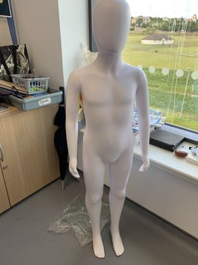
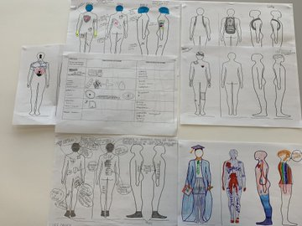
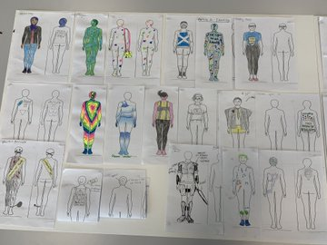
S1-6 pupil ideas for our Rights Mascot project in UPS during Rights Week.

Slide 15

What's next?
Working towards Gold Award
Continue to embed rights across Lossie High School
Prefects to promote specific rights each term

