Slide 1
CFE Advanced Higher Chemistry
Molecular orbitals

Slide 2
You should now be able to state:
molecular bonding orbitals are formed by the overlap of orbitals from individual atoms when bonding.
hybridisation occurs when different types of atomic orbitals are mixed.
sigma bonds are formed when two half filled atomic orbitals overlap end-on.
pi bonds are formed when two half filled atomic orbitals overlap side-on.
where compounds fit onto the bonding continuum is determined by the difference in electronegativity between bonded atoms.

Slide 3
Bonding in Alkanes
Covalent bonding involves the sharing of electron. This is caused by the overlap of half-filled orbitals.
From standard grade, carbon always forms four bonds.
e.g. CH₄ – methane.

Slide 4
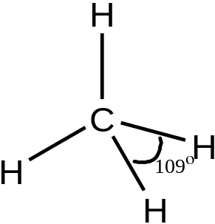

Bonding in Alkanes
Looking at the electron arrangement of carbon 1s² 2s² 2p², there are only two half-filled orbitals.
You might expect carbon to form 2 bonds as it only has 2 unpaired electrons.
All four bonds within a methane molecule have been measured and found to be identical, therefore each of the half-filled orbitals involved in the bonding must be degenarate.

Slide 5
sp³ Hybridisation
2p
sp³
E
2s
E
1s
1s
Orbitals in free C atom
Hybridized orbitals of C atom in methane
The 2s and 2p orbitals undergo hybridisation to form four new sp³ orbitals.
Each of these hybrid orbitals are known as an sp³ orbital as they are formed from one s orbital and three p orbitals.
The FOUR sp³ hybrids are DEGENERATE

Slide 6



sp³ orbitals
The three sp³ orbitals are tetrahedrally arranged due to the repulsion caused by electrons.
The shape of a sp³ orbital differs from that of an s and p orbital. It is more strongly pulled in one direction.
s p sp³

Slide 7
sp³ orbitals
sp³ orbitals
C
Now form the bonds to the H-atoms……...

Slide 8
Each bond in methane results from the overlap of a hydrogen 1s orbital and a carbon sp³ orbital.
Carbon sp³ orbitals
Hydrogen 1s orbital
H
Form a chemical bond by sharing a pair of electrons.
C
H
H
H
σ bonds

Slide 9
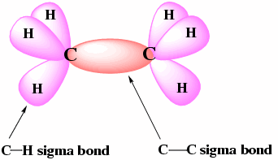
Sigma Bonds
Sigma bonds (σ bonds) are formed by the end on overlap of two orbitals on the same axis.
e.g. ethane

Slide 10
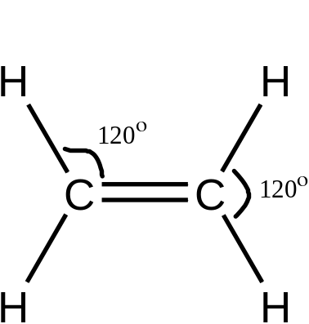
Bonding in Alkenes
The orbital arrangement in alkenes must differ from that in alkanes as there are many differences between the two types of molecule:
- Ethene molecule is planar (120º angles)
- C=C bond length is shorter than C-C
- C=C bond enthalpy is stronger than C-C but not double
- There is restricted rotation around the C=C but not the C-C.

Slide 11
sp² Hybridisation
2p
2p
sp²
E
2s
E
1s
1s
GROUND STATE C atom
sp² hybridized orbitals of C
HYBRIDIZE
Three hybrid orbitals are obtained which lie at 120º to each other.
The remaining p orbital lies at 90º to the new sp² orbitals.

Slide 12
An sp² hydridized C atom
sp² - hybrid orbitals
UNHYBRIDIZED
p- orbital
z
y
x
The unhybridized p orbital is perpendicular to sp² plane.

Slide 13
sp² orbitals & sigma bonds
In ethene, two of the sp² orbitals of carbon can overlap with the s orbital of hydrogen to form sigma bonds.
A sigma bonds also forms between the two carbon atoms.

Slide 14
BONDING IN ETHANE
H
H
C
C
σ bond
H
H
z
z
y
y
C
C
x
x
OVERLAP the sp² hybrids from the two carbons to form a sigma bond between them.

Slide 15
π bonds
The unhybridised p orbitals can overlap sideways with each other forming a new bond – π (Pi) bond.
The sideways overlap of the p orbitals is less effective than end-on overlap, therefore a sigma bond is stronger than a π bond.
The carbon to carbon double bond is therefore a result of one sigma bond (overlap of sp² orbitals) and one π bond (overlap of unhybridised p orbitals).

Slide 16
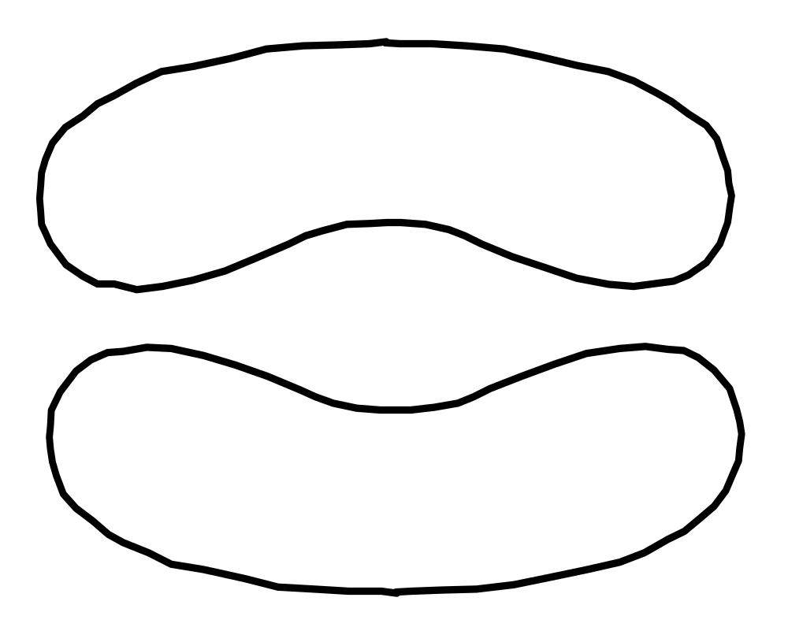
The two unhybridized p orbitals are left over to form a …..
z
z
H
H
y
y
H
H
x
x
π bond (pi bond)

Slide 17
Bonding Scheme in ethyne
TWO π bonds
one σ bond
one σ bond
H
C
C
H
one σ bond
What does this look like????

Slide 18
OVERLAP the C sp hybrids with H 1s to form sigma bonds
z
z
H
y
y
C
H
C
x
x

Slide 19
LATERAL OVERLAP of p orbitals to form pi bonds.
z
z
H
y
y
H
C
C
x
x
two π bonds (pi bonds)

