Slide 1
Stereochemistry

Slide 2
You should now be able to state that:
stereoisomers are isomers that have the same molecular formula but differ in structural formulae.
geometric isomers are stereoiosmers where there is a lack of rotation around one of the bonds mostly a C=C.
these isomers are labelled cis and trans dependent on whether the substitutes are on the same or different sides of the C=C.
optical isomers are non-superimposable mirror images of asymmetric molecules and are referred to as chiral molecules or enantiomers.
isomers can often have very different physical or chemical properties from each other.

Slide 3
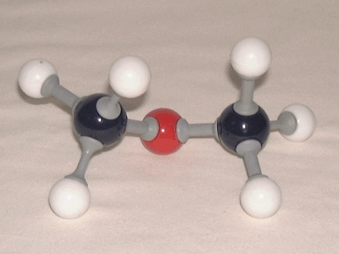
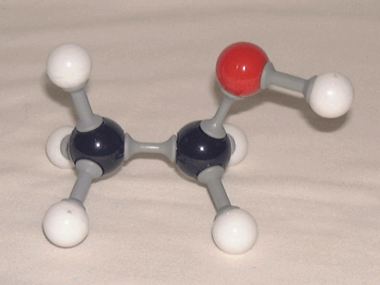
Structural Isomers
Dimethyl ether and ethanol are structural isomers as they have the same molecular formula but different structures.

Slide 4
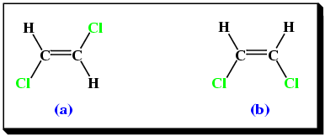
Geometric Isomerism
In geometric isomerism, there is a lack of free rotation around a bond (e.g. around a C=C).
1,2-dichloroethane has two geometric isomers.

Slide 5
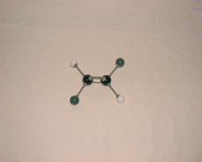
Cis- and Trans - Isomers

Slide 6
Geometric Isomerism
Geometric isomers can be distinguished in two ways:
cis - both groups are on the same side of the double bond.
trans - the groups are on the opposite sides of the double bond.

Slide 7
Cis- and Trans - Isomers
Molecule (a) is the trans isomer.
Molecule (b) is the cis isomer.

Slide 8
Cis- and Trans - Isomers
Trans isomers tend to have higher melting points than cis isomers thus, showing that they have stronger intermolecular forces.
The trans molecules are closer packed and have stronger van der Waals forces.

Slide 9
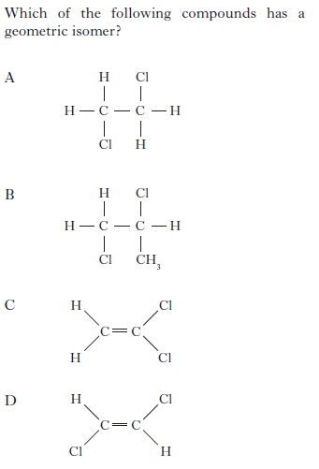
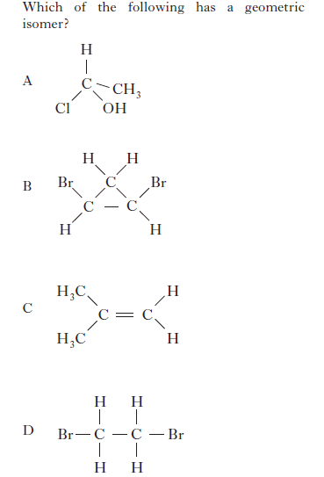

Slide 10
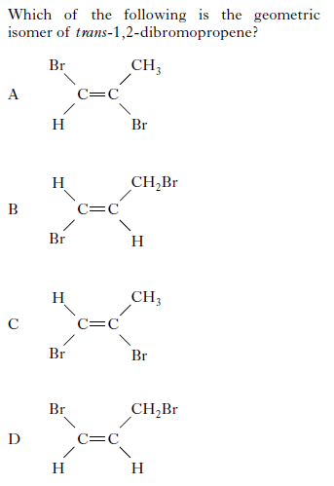

Slide 12
Stereoisomerism
Stereoisomerism means that the molecules have the same molecular formula and the same structural formula but have a different three dimensional arrangement in space.
They are non-superimposable, cannot fit exactly on top of each other.

Slide 13
Optical Isomerism
Optical isomerism can occur in compounds with four different groups arranged around a carbon atom.
This leads to CHIRAL molecules that are non-superimposable mirror images of each other.

Slide 14
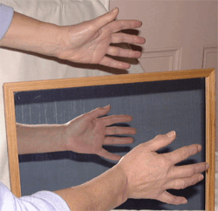
Optical Isomerism
Right and left hands are asymmetrical.
They cannot be superimposed on each other.
They are chiral (i.e. lack symmetry).

Slide 15
Carbon and Symmetry
A tetrahedral carbon atom with four different groups is asymmetric.
Molecules containing one or more asymmetric carbon atoms are usually (but not always) also asymmetric.
Asymmetric atoms or molecules are described as chiral with the carbon atom being called the chiral centre.

Slide 16
Carbon and Symmetry
They differ from each other only in that they are mirror images of each other and exhibit optical activity. Such isomers are called enantiomers or optical isomers.
The crystals of enantiomers are mirror images of each other.
A mixture containing equal amounts of each enantiomer is known as a racemic mixture.

Slide 17
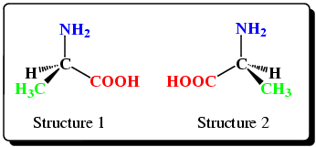
Amino Acids
The amino acid alanine is non-superimposable on top of its mirror image therefore is an optical isomer.
There are the two enantiomers of alanine.

Slide 18
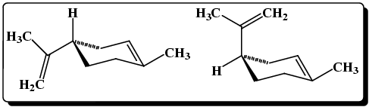
Enantiomers
Enantiomers have the same physical and chemical properties except when in the presence of other chiral molecules.
The enantiomers below of limonene have different smells, one orange and the other lemon.

Slide 19
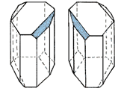
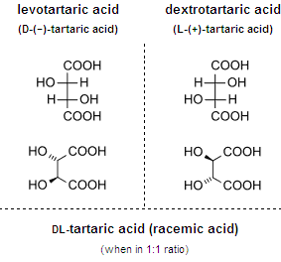
Louis Pasteur
Separating enatiomers (racemic mixtures) if very difficult.
He separated the two enantiomers using tweezer and went on to show that one enantiomer could be converted to another.

Slide 20
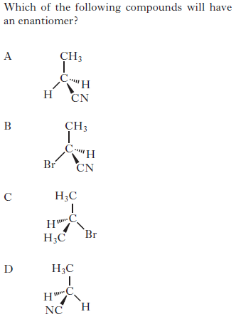
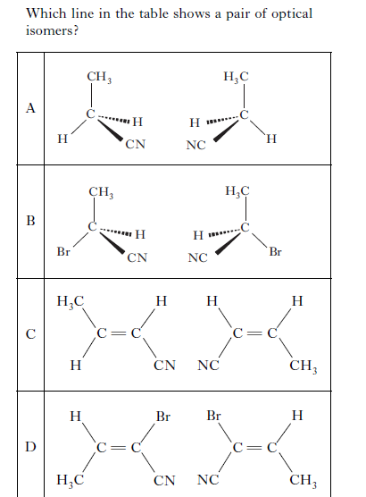

Slide 21
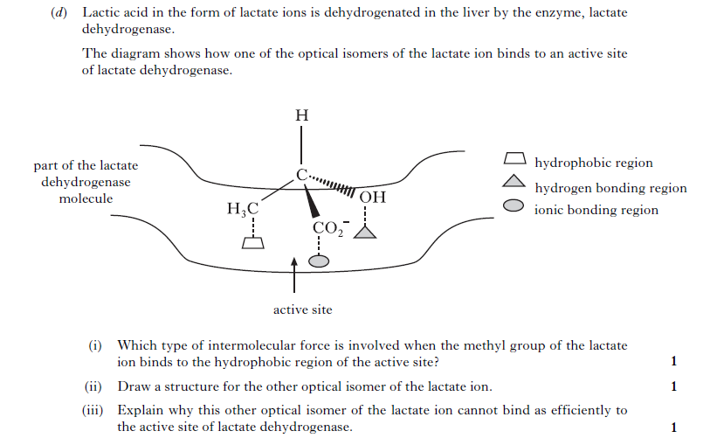

Slide 22
Polarimeter.
A polarimeter is used to allow light of only a single plane to pass through.
Enantiomers have different effects on polarised light.

Slide 23
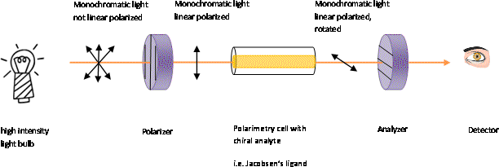
Polorimeter
If the substance is optical inactive, the plane of the polarized light will not change in orientation and the observer will read an angle of [α]= 0º

Slide 24
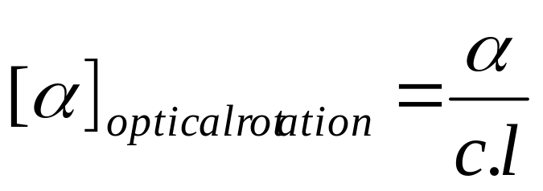
Polorimeter
Generally the following equation is used to calculate the specific optical rotation from experimental data:
α = observed optical rotation
c = the concentration of the solution in grams per milliliter
l = the length of the tube in decimeters (1 dm=10 cm)

Slide 25
X-ray Crystallography
By using X-rays, which are diffracted by atoms in much the same way as light is by a diffraction grating, a pattern of diffracted spots is obtained when radiation passes through a crystal of material.

Slide 26
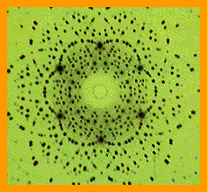
X-ray Crystallography
It is the electrons in the atoms/ions of the crystal that cause the X-rays to scatter.
The intensities of the spot correspond to the electron densities.

Slide 27
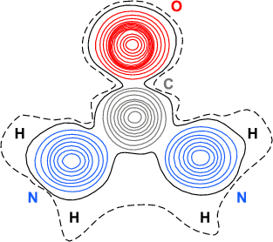
Electron Density Maps
This is the electron density map for urea (CO(NH₂)₂).
Hydrogen atoms are difficult to detect as they only have one electron.

